Slide 1
Supervised Speech Separation
DeLiang Wang
Perception & Neurodynamics Lab
Ohio State University
& Northwestern Polytechnical University
http://www.cse.ohio-state.edu/pnl/

Slide 2
Outline of presentation
Introduction: Speech separation problem
Classifiers and learning machines
Training targets
Features
Separation algorithms
Concluding remarks

Slide 3
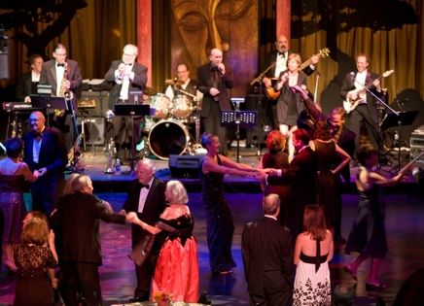
Real-world audition
What?
Speech
message
speaker
age, gender, linguistic origin, mood, …
Music
Car passing by
Where?
Left, right, up, down
How close?
Channel characteristics
Environment characteristics
Room reverberation
Ambient noise
Notes:
3

Slide 4

Sources of intrusion and distortion
additive noise from
other sound sources
channel distortion
reverberation from
surface reflections
Notes:
4

Slide 5
Cocktail party problem
Term coined by Cherry
“One of our most important faculties is our ability to listen to, and follow, one speaker in the presence of others. This is such a common experience that we may take it for granted; we may call it ‘the cocktail party problem’…” (Cherry’57)
“For ‘cocktail party’-like situations… when all voices are equally loud, speech remains intelligible for normal-hearing listeners even when there are as many as six interfering talkers” (Bronkhorst & Plomp’92)
Ball-room problem by Helmholtz
“Complicated beyond conception” (Helmholtz, 1863)
Speech separation problem
Separation and enhancement are used interchangeably when dealing with nonspeech interference
Notes:
5

Slide 6
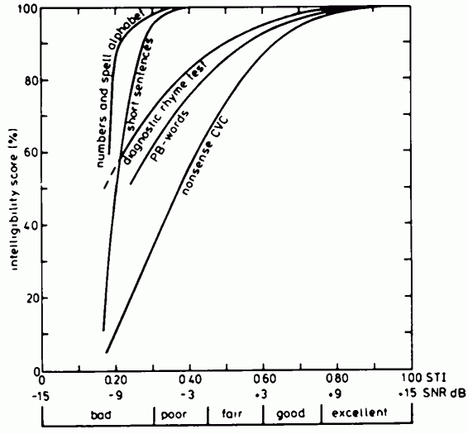
Listener performance
Speech reception threshold (SRT)
The speech-to-noise ratio needed for 50% intelligibility
Each 1 dB gain in SRT corresponds to about 10% increase in intelligibility dependent upon materials
Source: Steeneken (1992)
Notes:
6
From Steeneken “The listener has to recognize a word or sentence presented at a fixed level and masked by noise at a variable level. After a correct response the noise level is increased, while after a false response the noise level is decreased. This procedure leads to an estimation of the noise level where a 50% correct identification of the words or sentences is obtained (Plomp & Mimpen, 1979)” -- can be performed with naïve listeners and gives very reproducible results (sd of masking noise level is close to 1.5 dB)
So what has subsequent investigation revealed about the cues actually used and (seemingly) not used: throws up a few surprises

Slide 7
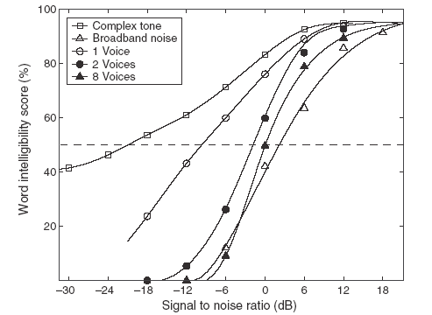
Effects of competing source
SRT
Difference
(23 dB!)
Source: Wang & Brown (2006)
Notes:
7
don’t comment at this point on the effect of competing speakers

Slide 8
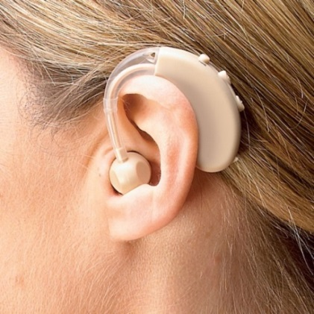
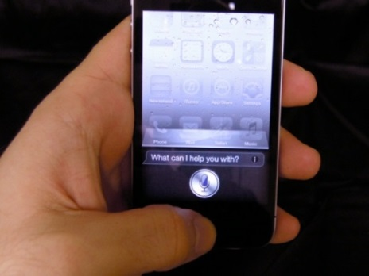
Some applications of speech separation
Robust automatic speech and speaker recognition
Noise reduction for hearing prosthesis
Hearing aids
Cochlear implants
Noise reduction for mobile communication
Audio information retrieval

Slide 9
Traditional approaches to speech separation
Speech enhancement
Monaural methods by analyzing general statistics of speech and noise
Require a noise estimate
Spatial filtering with a microphone array
Beamforming
Extract target sound from a specific spatial direction with a sensor array
Independent component analysis
Find a demixing matrix from multiple mixtures of sound sources
Computational auditory scene analysis (CASA)
Based on auditory scene analysis principles
Feature-based (e.g. pitch) versus model-based (e.g. speaker model)
Notes:
9

Slide 10
Supervised approach to speech separation
Data driven, i.e. dependency on a training set
Born out of CASA
Time-frequency masking concept has led to the formulation of speech separation as a supervised learning problem
A recent trend fueled in part by the success of deep learning
Focus of this tutorial
Notes:
10

Slide 11
Ideal binary mask as a separation goal
Motivated by the auditory masking phenomenon and auditory scene analysis, we suggested the ideal binary mask as a main goal of CASA (Hu & Wang, 2001; 2004)
The idea is to retain parts of a mixture where the target sound is stronger than the acoustic background, and discard the rest
The definition of the ideal binary mask (IBM)
θ: A local SNR criterion (LC) in dB, which is typically chosen to be 0 dB
Optimal SNR: Under certain conditions the IBM with θ = 0 dB is the optimal binary mask in terms of SNR gain (Li & Wang’09)
Maximal articulation index (AI) in a simplified version (Loizou & Kim’11)
It does not actually separate the mixture!

Slide 12
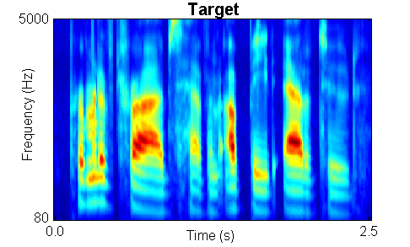
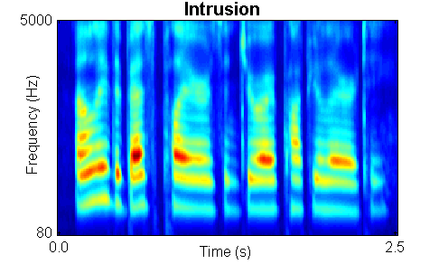

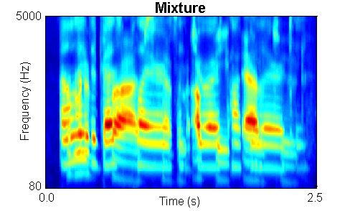
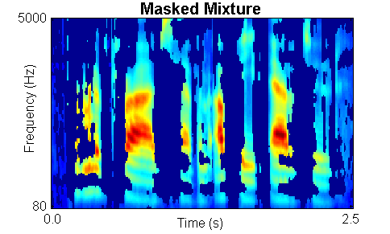
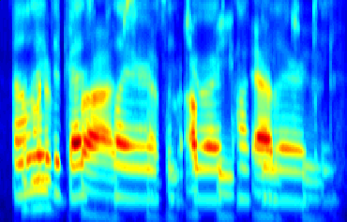
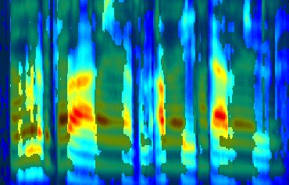
IBM illustration

Slide 13
Subject tests of ideal binary masking
IBM separation leads to large speech intelligibility improvements
Improvement for stationary noise is above 7 dB for normal-hearing (NH) listeners (Brungart et al.’06; Li & Loizou’08; Cao et al.’11; Ahmadi et al.’13), and above 9 dB for hearing-impaired (HI) listeners (Anzalone et al.’06; Wang et al.’09)
Improvement for modulated noise is significantly larger than for stationary noise
With the IBM as the goal, the speech separation problem becomes a binary classification problem
This new formulation opens the problem to a variety of pattern classification methods
Notes:
Brungart and Simpson (2001)’s experiments show coexistence of informational and energetic masking.
They have also isolated informational masking using across-ear effect when listening to two talkers in one ear experience informational masking from third signal in the opposite ear (Brungart and Simpson, 2002)
Arbogast et al. (2002) divide speech signal into 15 log spaced, envelope modulated sinewaves. Assign some to target and some to interference: intelligible speech with no spectral overlaps

Slide 14
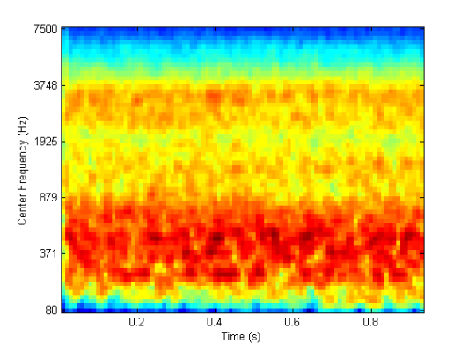

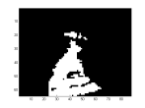
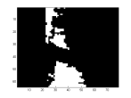
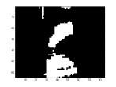
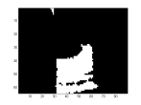
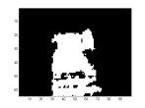
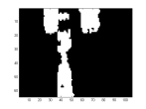
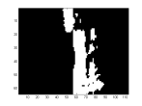
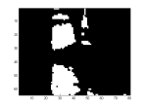
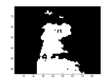
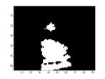
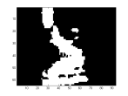
Speech perception of noise with binary gains
Wang et al. (2008) found that, when LC is chosen to be the same as the input SNR, nearly perfect intelligibility is obtained when input SNR is -∞ dB (i.e. the mixture contains noise only with no target speech)
IBM modulated noise for ???
Speech shaped noise
Notes:
Create a continuous noise signal that match long-term average spectrum of speech
Further approach to divide “speech-spectrum-shaped” noise into number of bands and modulate with natural speech envelopes
However, noise signal too “speech-like” and reintroduce informational masking (Brungart et al. 2004)
Alternatively, use Ideal Binary Mask to remove informational masking
Eliminate portions of stimulus dominated by the interfering speech.
Retain only portions of target speech acoustically detectable in the presence of interfering speech

Slide 15
Part II: Classifiers and learning machines
Multilayer perceptrons (MLPs)
Deep neural networks (DNNs)
Notes:
15

Slide 16
Multilayer perceptrons
Multilayer perceptrons are extended from perceptrons (or simple perceptrons)
The task is to learn from examples, and then generalize to unseen samples
A core learning approach in neural networks

Slide 17
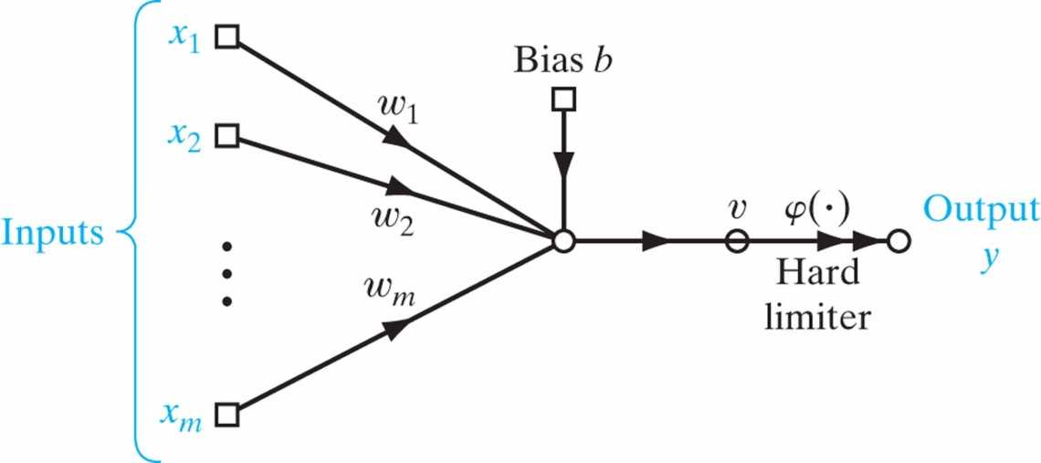
Perceptrons
First learning machine
Aiming for classification (apples vs. oranges)
Architecture: one-layer feedforward net
Without loss of generality, consider a single-neuron perceptron
x₁
y₁
x₂
y₂
•
•
•
•
•
•
x_{m}

Slide 18
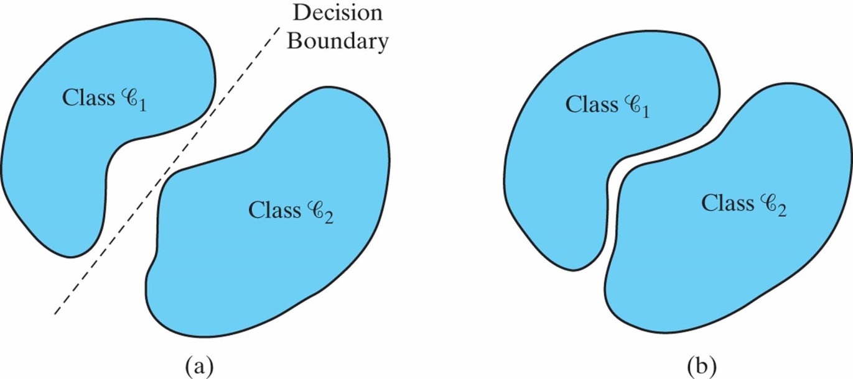
Linear separability
A perceptron separates the input space into two halves via a linear boundary
Perceptrons cannot classify linearly inseparable classes

Slide 19
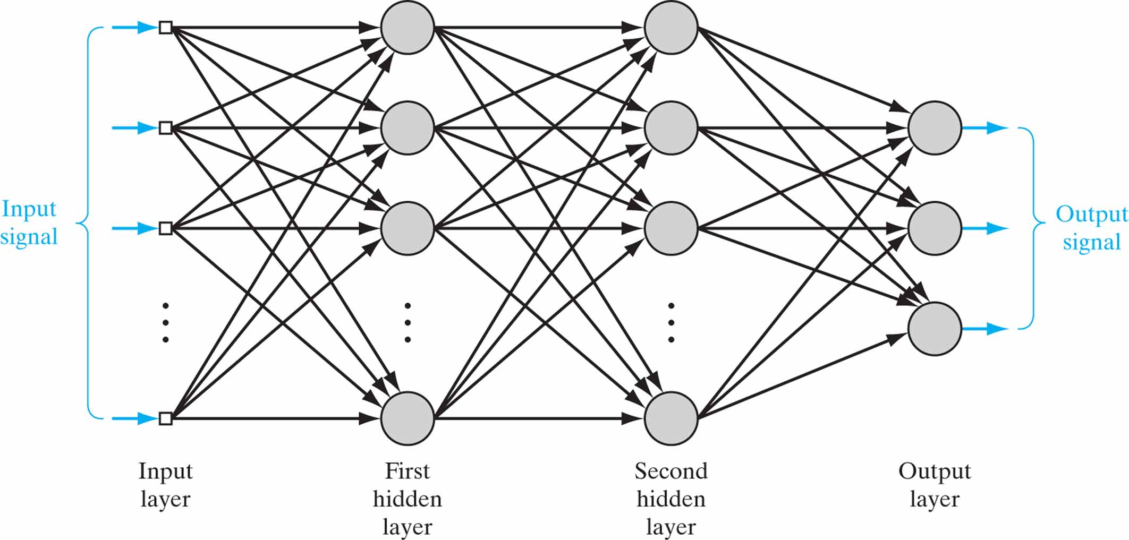
Multilayer perceptrons
If a training set is not linearly separable, a multilayer perceptron can give a solution

Slide 20
Backpropagation algorithm
Square error (loss) function between the desired (teaching) signal and actual output
Key question: how to minimize the error function by updating weights in multilayer structure with nonlinear activation functions?
Solution: apply the technique of gradient descent over weights
Gradient points to the direction of maximum E increase
Gradient descent leads to errors back-propagated layer by layer
Hence the name of the algorithm

Slide 21
Deep neural networks
Why deep?
As the number of layers increases, more abstract features are learned and they tend to be more invariant to superficial variations
Superior performance in practice if properly trained (e.g., convolutional neural networks)
The backprop algorithm is applicable to an arbitrary number of layers
However, deep structure is hard to train from random initializations
Vanishing gradients: Error derivatives tend to become very small in lower layers

Slide 22
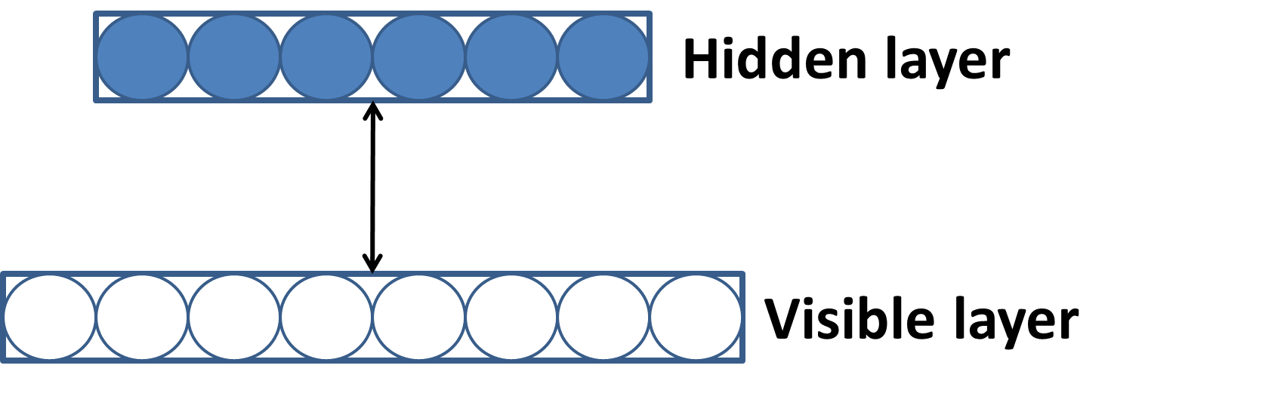
Restricted Boltzmann machines
Hinton et al. (2006) suggest to unsupervisedly pretrain a DNN using restricted Boltzmann machines (RBMs)
RBMs simplify Boltzmann machines by allowing connections only between the visible and hidden layer, i.e. no intra-layer recurrent connections
Enables exact and efficient inference

Slide 23
DNN training
Unsupervised, layerwise RBM pretraining
Train the first RBM using unlabeled data
Fix the first layer weights. Use the resulting hidden activations as new data to train the second RBM
Continue until all layers are thus trained
Supervised fine-tuning
The weights from RBM pretraining provide the network initialization
Use standard backpropagation to fine tune all the weights for a particular task at hand
Recent practice suggests that RBM pretraining is not needed if large training data exists

Slide 24
Part III: Training targets
What supervised training aims to learn is important for speech separation/enhancement
Different training targets lead to different mapping functions from noisy features to separated speech
Different targets may have different levels of generalization
A recent study (Wang et al.’14) examines different training targets (objective functions)
Masking based targets
Mapping based targets
Other targets
Notes:
24

Slide 25
Background
While the IBM is first used in supervised separation (see Part V), the quality of separated speech is a persistent issue
What are alternative targets?
Target binary mask (TBM) (Kjems et al.’09; Gonzalez & Brookes’14)
Ideal ratio mask (IRM) (Srinivasan et al.’06; Narayanan & Wang’13; Hummersone et al.’14)
STFT spectral magnitude (Xu et al.’14; Han et al.’14)

Slide 26
Different training targets
TBM: similar to the IBM except that interference is fixed to speech-shaped noise (SSN)
IRM
β is a tunable parameter, and a good choice is 0.5
With β = 0.5, the IRM becomes a square root Wiener filter, which is the optimal estimator of the power spectrum

Slide 27
Different training targets (cont.)
Gammatone frequency power spectrum (GF-POW)
FFT-MAG of clean speech
FFT-MASK

Slide 28
Illustration of various training targets
Factory noise at -5 dB

Slide 29
Evaluation methodology
Learning machine: DNN with 3 hidden layers, each with 1024 units
Target speech: TIMIT
Noises: SSN + four nonstationary noises from NOISEX
Training and testing on different segments of each noise
Trained at -5 and 0 dB, and tested at -5, 0, and 5 dB
Evaluation metrics
STOI: standard metric for predicted speech intelligibility
PESQ: standard metric for perceptual speech quality
SNR

Slide 30
Comparisons
Comparisons among different training targets
Trained and tested on each noise, but different segments
An additional comparison for the IRM target with multi-condition (MC) training of all noises (MC-IRM)
Comparisons with different approaches
Speech enhancement (Hendriks et al.’10)
Supervised NMF: ASNA-NMF (Virtanen et al.’13), trained and tested in the same way as supervised separation

Slide 31
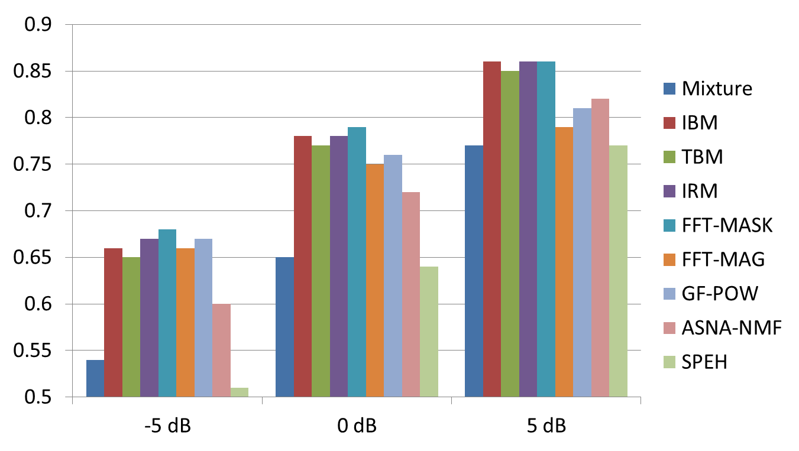
STOI comparison for factory noise
Spectral mapping
NMF & SPEH
Masking

Slide 32
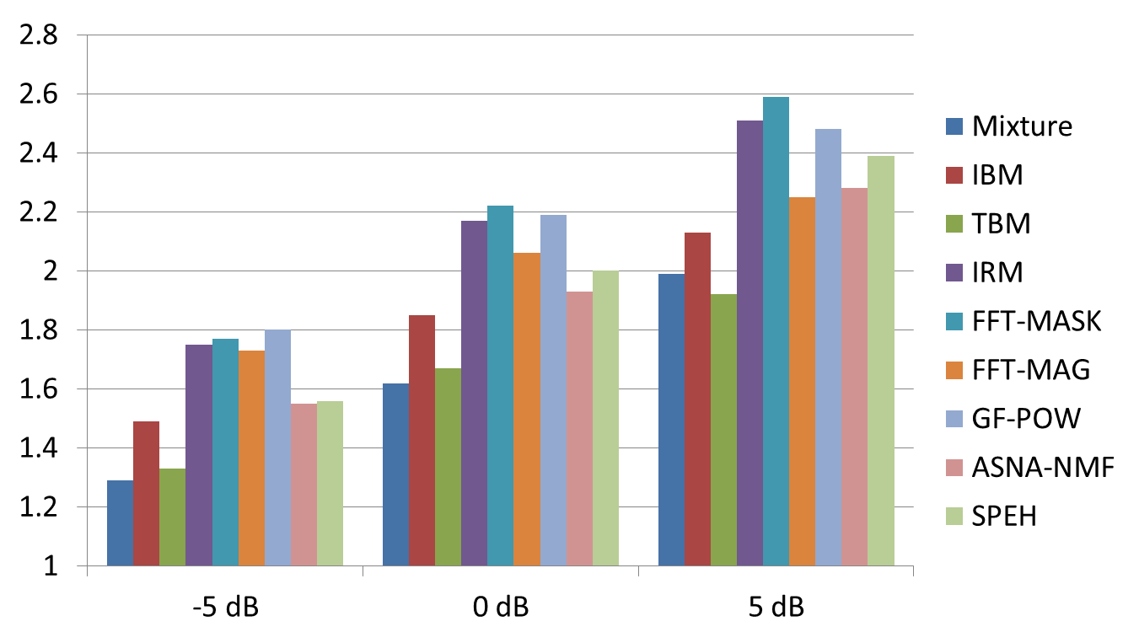
PESQ comparison for factory noise
Spectral mapping
Masking
NMF & SPEH

Slide 33
Summary among different targets
Among the two binary masks, IBM estimation performs better in PESQ than TBM estimation
Ratio masking performs better than binary masking for speech quality
IRM, FFT-MASK, and GF-POW produce comparable PESQ results
FFT-MASK is better than FFT-MAG for estimation
Many-to-one mapping in FFT-MAG vs. one-to-one mapping in FFT-MASK, and the latter should be easier to learn
Estimation of spectral magnitudes or their compressed version tends to magnify estimation errors

Slide 34
Other targets: signal approximation
In signal approximation (SA), training aims to estimate the IRM but the error is measured against the spectral magnitude of clean speech (Weninger et al.’14)
RM(t, f) denotes an estimated IRM
This objective function maximizes SNR
Jin & Wang (2009) proposed an earlier version in conjunction with IBM estimation
There is some improvement over direct IRM estimation

Slide 35
Phase-sensitive target
Phase-sensitive target is an ideal ratio mask (FFT mask) that incorporates the phase difference, θ, between clean speech and noisy speech (Erdogan et al.’15)
Because of phase sensitivity, this target leads to a better estimate of clean speech than the FFT mask
It does not directly estimate phase
We will come back to this issue later

Slide 36
Part IV: Features for supervised separation
For supervised learning, features and learning machines are two key components
Early studies only used a few features
ITD/ILD (Roman et al.’03)
Pitch (Jin et al.’09)
Amplitude modulation spectrogram (AMS) (Kim et al.’09)
A subsequent study expanded the list (Wang et al.’13)
Newly included: MFCC, GFCC, PLP, and RASTA-PLP
A complementary set is recommended: AMS+RASTA-PLP+MFCC (and PITCH)

Slide 37
A systematic feature study
Chen et al. (2014) have evaluated an extensive list of acoustic features, previously used for robust ASR, for classification-based speech separation
Evaluation done at the low SNR level of -5 dB, with implications for speech intelligibility improvements
In addition to existing features, a new feature called Multi-Resolution Cochleagram (MRCG) was introduced
Classifier is fixed to an MLP

Slide 38
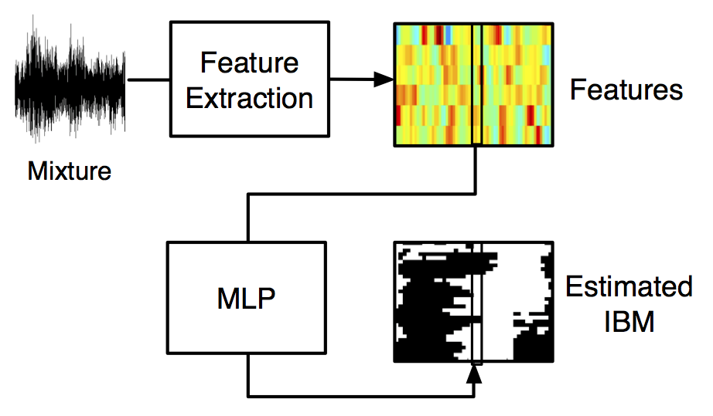
Evaluation framework
Each frame of features is sent to an MLP to estimate a frame of the IBM
A single fullband classifier

Slide 39
Evaluation criteria
Two criteria are used to measure the quality of IBM estimation:
Classification accuracy
HIT – FA rate, which is well correlated with human speech intelligibility (Kim et al.'09)

Slide 40
Multi-resolution cochleagram
MRCG is constructed by combining multiple cochleagrams at different resolutions
A high-resolution cochleagram captures local information, while a low-resolution cochleagram captures information in a broader spectrotemporal context

Slide 41
MRCG derivation
Steps for computing MRCG:
Given an input mixture, compute the first 64-channel cochleagram, CG1, with the frame length of 20 ms and frame shift of 10 ms. This is a common form of cochleagram. A log operation is applied to the energy of each T-F unit.
Similarly, compute CG2 with the frame length of 200 ms and frame shift of 10 ms.
CG3 is derived by averaging CG1 across a square window of 11 frequency channels and 11 time frames centered at a given T-F unit.
If the window goes beyond the given cochleagram, the outside units take the value of zero (i.e. zero padding)
CG4 is computed in a similar way to CG3, except that a 23×23 square window is used
Concatenate CG1-CG4 to obtain the MRCG feature, which has 64×4 dimensions for each time frame

Slide 42
MRCG visualization
Left: MRCG from a noisy mixture (-5 dB babble)
Right: MRCG from clean speech

Slide 43
Experimental setup
Speech from the IEEE male corpus and six nonstationary NOISEX noises
480 sentences for training and another 50 sentences for testing
First half of each 4-minute noise is used for training, and second half for testing
Mixture SNR is fixed to -5 dB
The hidden layer of MLP has 300 units

Slide 44
Features considered
As robust ASR is likely related to speech separation, Chen et al. constructed an extensive list of features from robust ASR research
A subset of promising features is selected based on their ASR performance at low SNRs and for nonstationary noises

Slide 45
Features selected for evaluation
In addition to those previously studied for speech separation, newly selected ones include
Gammatone frequency modulation coefficient (GFMC; Maganti & Matassoni’10)
Zero-crossing with peak-amplitude (ZCPA, Kim et al.’99)
Relative autocorrelation sequence MFCC (RAS-MFCC, Yuo & Wang’99)
Autocorrelation sequence MFCC (AC-MFCC, Shannon & Paliwal’06)
Phase autocorrelation MFCC (PAC-MFCC, Ikbal et al.’03)
Power normalized cepstral coefficient (PNCC, Kim & Stern’12)
Gabor filterbank (GFB) feature (Schadler et al.’12)
Delta-spectral cepstral coefficient (DSCC, Kumar et al.’11)
Suppression of slowly-varying components and the falling edge of the power envelope (SSF, Kim & Stern’10)

Slide 46
Classification accuracy

Slide 47
HIT – FA rate in % (FA in parentheses)

Slide 48
Result summary
MRCG feature performs the best consistently
Gammatone-domain features (MRCG, GF and GFCC) perform best
Cepstral (DCT) compaction does not help
GF is better than GFCC
Modulation-domain features do not help
GFCC better than GMFC, with the latter derived from the former
MFCC with ARMA filtering performs reasonably well
Poor performance of pitch is largely due to pitch estimation errors at -5 dB SNR

Slide 49
Part V. Separation algorithms
Monaural separation
Speech-nonspeech separation
Complex-domain separation
Two-talker separation
Separation of reverberant speech
Binaural separation
Notes:
49

Slide 50
Early monaural attempts at IBM estimation
Jin & Wang (2009) proposed MLP-based classification to separate reverberant voiced speech
A 6-dimensional pitch-based feature is extracted within each T-F unit
Classification aims at the IBM, but with a training target that takes into account of the relative energy of the T-F unit
Kim et al. (2009) proposed GMM-based classification to perform speech separation in a masker dependent way
AMS features are extracted within each T-F unit
Lower LCs are used at higher frequencies in the IBM definition
First monaural speech segregation algorithm to achieve speech intelligibility improvement for NH listeners

Slide 51
DNN as subband classifier
Y. Wang & Wang (2013) first introduced DNN to address the speech separation problem
DNN is used for as a subband classifier, performing feature learning from raw acoustic features
Classification aims to estimate the IBM

Slide 52
DNN as subband classifier

Slide 53
Extensive training with DNN
Training on 200 randomly chosen utterances from both male and female IEEE speakers, mixed with 100 environmental noises at 0 dB (~17 hours long)
Six million fully dense training samples in each channel, with 64 channels in total
Evaluated on 20 unseen speakers mixed with 20 unseen noises at 0 dB

Slide 54
DNN-based separation results
Comparisons with a representative speech enhancement algorithm (Hendriks et al.’10)
Using clean speech as ground truth, on average about 3 dB SNR improvements
Using IBM separated speech as ground truth, on average about 5 dB SNR improvements

Slide 55
Speech intelligibility evaluation
Healy et al. (2013) subsequently evaluated the classifier on speech intelligibility of hearing-impaired listeners
A very challenging problem: “The interfering effect of background noise is the single greatest problem reported by hearing aid wearers” (Dillon’12)
Two stage DNN training to incorporate T-F context in classification

Slide 56
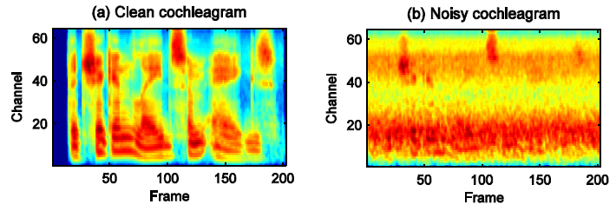
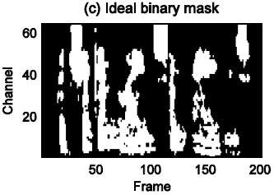
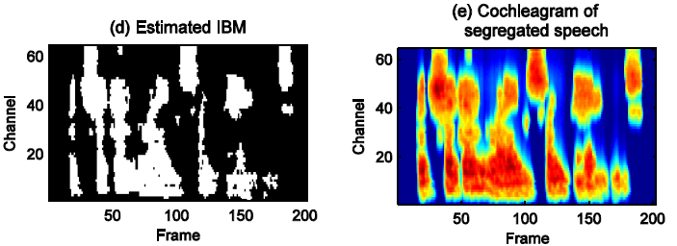
Separation illustration
A HINT sentence mixed with speech-shaped noise at -5 dB SNR

Slide 57
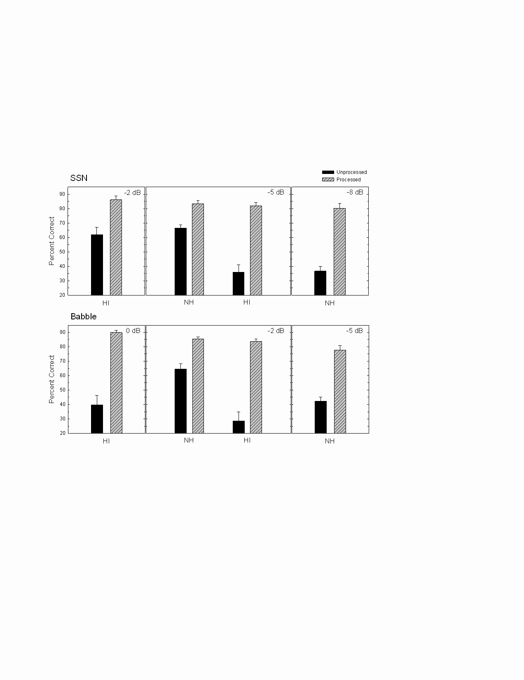

Results and sound demos
Both HI and NH listeners showed intelligibility improvements
HI subjects with separation outperformed NH subjects without separation

Slide 58
DNN as spectral magnitude estimator
Xu et al. (2014) proposed a DNN-based enhancement algorithm
DNN (with RBM pretraining) is trained to map from log-power spectra of noisy speech to those of clean speech
More input frames and training data improve separation results

Slide 59
Xu et al. results in PESQ
With trained noises
Subscript in DNN denotes number of hidden layers
With two untrained noises (A: car; B: exhibition hall)

Slide 60
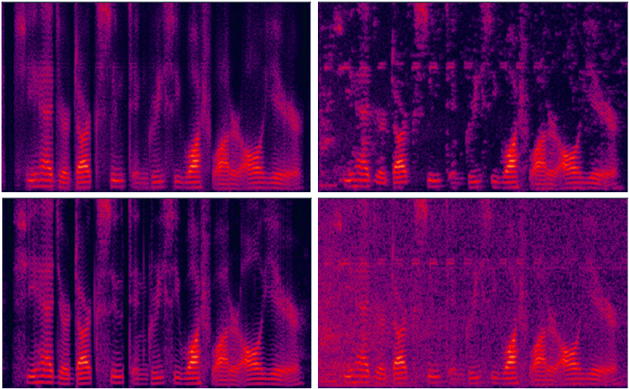
Xu et al. demo
Street noise at 10 dB (upper left: DNN; upper right: log-MMSE; lower left: clean; lower right: noisy)

Slide 61
Part V. Separation algorithms
Monaural separation
Speech-nonspeech separation
Complex-domain separation
Two-talker separation
Separation of reverberant speech
Binaural separation
Notes:
61

Slide 62
Complex-domain ratio masking
Typical speech separation systems operate in the T-F domain
Common practice enhances magnitude response, but leaves phase response unchanged
Paliwal et al. (2010), however, showed significant speech quality improvements when using clean phase with noisy magnitude
In negative SNR conditions, phase estimation becomes more important as the phase of noisy speech reflects that of background noise more than that of speech
Learn to estimate phase
It appears that phase estimation is a well tailored problem for supervised learning
Despite considerable effort, however, such phase estimation has not succeeded

Slide 63
Why?
Likely due to the lack of structure in phase responses
Supervised learning requires structure (redundancy) in the data in order to generalize
Magnitude and phase spectrogram of clean speech

Slide 64
Complex ratio masking
Williamson et al. (2016) reveal that structure exists in the real and imaginary domains
Define the IRM in the complex domain, termed the complex Ideal Ratio Mask (cIRM)
By operating in the complex domain, the cIRM simultaneously enhances the magnitude and phase responses of noisy speech
The cIRM is capable of fully reconstructing original signal
They use DNN to jointly estimate the real and imaginary components of the cIRM
An oral presentation in the first Friday afternoon session (Speech Enhancement - Masking and Noise Modeling)

Slide 65
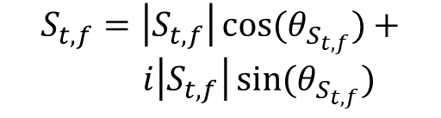
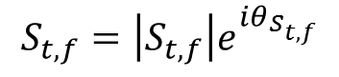
Structure in real and imaginary domains
Polar Coordinates
$$S_{t,f}=\left|S_{t,f}\right|e^{iθ_{S_{t,f}}}$$
Cartesian Coordinates
$$S_{t,f}=\left|S_{t,f}\right|\cos{{(θ}_{S_{t,f}})}+$$
$i\left|S_{t,f}\right|\sin{(θ_{S_{t,f}})}$
Both real and imaginary components of speech have clear structure, whereas phase spectrogram does not

Slide 66
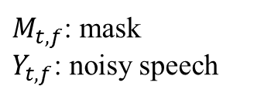
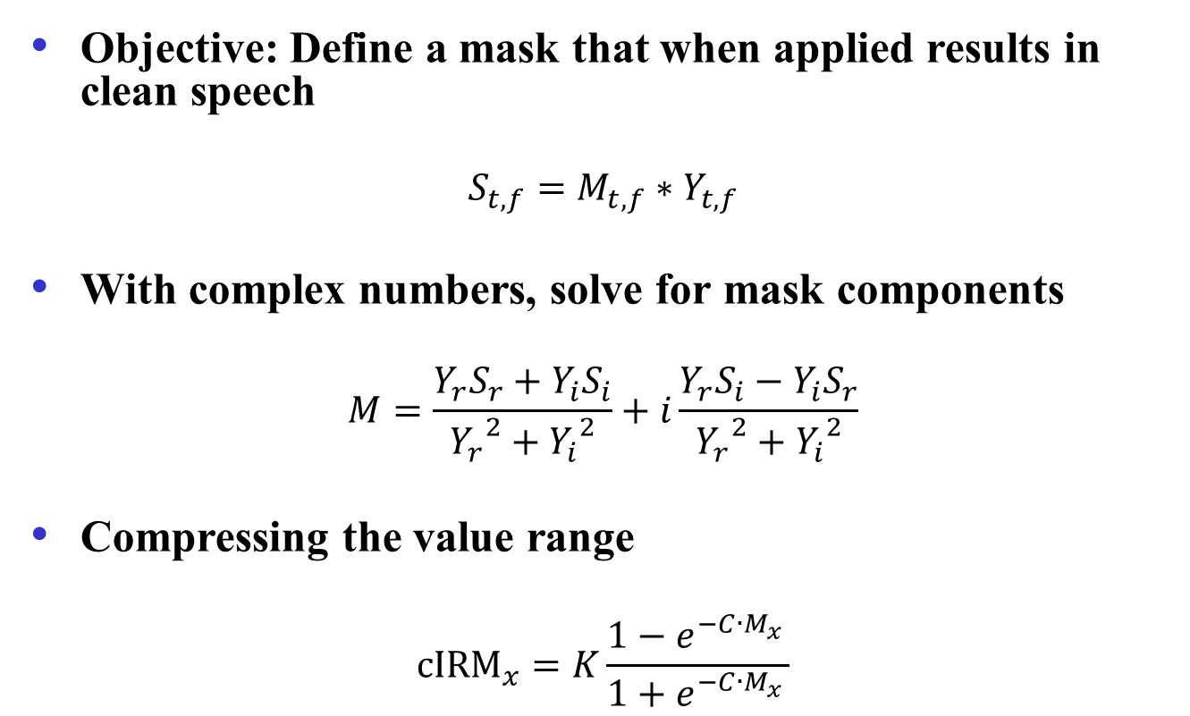
Complex Ideal Ratio Mask (cIRM)
Objective: Define a mask that when applied results in clean speech
$$S_{t,f}=M_{t,f}∗Y_{t,f}$$
With complex numbers, solve for mask components
$$M=\frac{Y_{r}S_{r}+Y_{i}S_{i}}{{Y_{r}}^{2}+{Y_{i}}^{2}}+i\frac{Y_{r}S_{i}−Y_{i}S_{r}}{{Y_{r}}^{2}+{Y_{i}}^{2}}$$
Compressing the value range
$${cIRM}_{x}=K\frac{1−e^{−C∙{M_{x}}_{}^{ }}}{1+e^{−C∙{M_{x}}_{}^{ }}}$$
$M_{t,f}$: mask
$Y_{t,f}$: noisy speech
x ∊ {r, i}

Slide 67
cIRM estimation
DNN is used to estimate the cIRM
Features: Complementary feature set (see Part IV)
Real and imaginary components are jointly estimated

Slide 68
Objective results and demos
 | PESQ | STOI
Noisy Speech | 1.92 | 0.66
Ratio Mask | 2.44 | 0.80
Ratio Mask with K & G Phase | 2.47 | 0.78
CMF | 2.15 | 0.72
Complex Ratio Mask | 2.60 | 0.80
Comparisons
Estimated IRM with enhanced phase (Krawczyk & Gerkmann’14)
Supervised complex nonnegative matrix factorization, or CMF (Parry & Essa’07)

Slide 69
Listening test
Existing quality metrics do not account for, and therefore may not fully reflect, the impact of phase on speech quality
Williamson et al. conducted a listening test to compare pairs of signals for quality preference
Strong preference for cRM

Slide 70
Part V. Separation algorithms
Monaural separation
Speech-nonspeech separation
Complex-domain separation
Two-talker separation
Separation of reverberant speech
Binaural separation
Notes:
70

Slide 71
DNN for two-talker separation
Huang et al. (2014; 2015) proposed a two-talker separation method based on DNN, as well as RNN (recurrent neural network)
Mapping from an input mixture to two separated speech signals
Using T-F masking to constrain target signals
Binary or ratio

Slide 72
Network architecture and training objective
A discriminative training objective maximizes signal-to-interference ratio (SIR)

Slide 73
Huang et al. results
DNN and RNN perform at about the same level
About 4-5 dB better in terms of SIR than NMF, while maintaining better SDRs and SARs (input SIR is 0 dB)
Demo at https://sites.google.com/site/deeplearningsourceseparation
Mixture
Binary masking
Separated
Talker 1
Talker 1
Ratio masking
Separated
Talker 2
Talker 2

Slide 74
Part V. Separation algorithms
Monaural separation
Speech-nonspeech separation
Complex-domain separation
Two-talker separation
Separation of reverberant speech
Binaural separation
Notes:
74

Slide 75
Reverberation
Reverberation is everywhere
Reflections from the original source (direct sound) from various surfaces
Adverse effects on speech processing, especially when mixed with noise
Speech communication
Automatic speech recognition
Speaker identification
Previous work
Inverse filtering (Avendano & Hermansky’96; Wu & Wang’06)
Binary masking (Roman & Woodruff’13; Hazrati et al.’13)

Slide 76
DNN for speech dereverberation
Learning the inverse process (Han et al.’14)
DNN to learn the mapping from the spectrum of reverberant speech to the spectrum of clean (anechoic) speech
Work equally well in spectrogram and cochleagram
Straightforward extension to separate reverberant and noisy speech

Slide 77
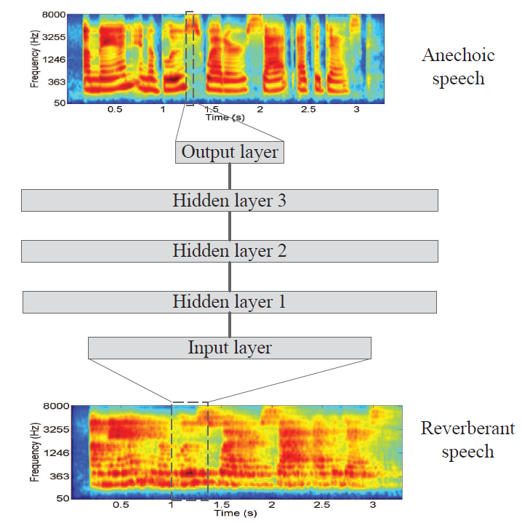
Learning spectral mapping
DNN
Rectified linear + sigmoid
Three hidden layers
Input: current frames + 5 neighboring frame on each side
Output: current frame

Slide 78
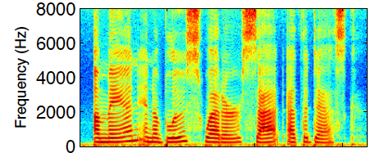
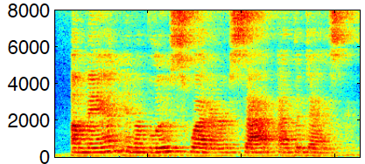
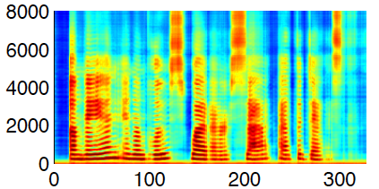
Dereverberation
Clean
Reverberant
(T₆₀ = 0.6 s)
Dereverberated

Slide 79

Dereverberation demo
Reverberant T₆₀ = 0.9 s
Dereverberated
Anechoic

Slide 80
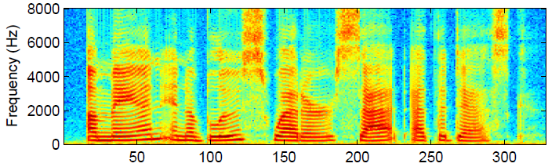
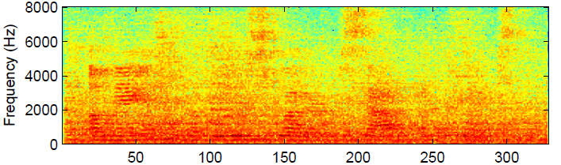
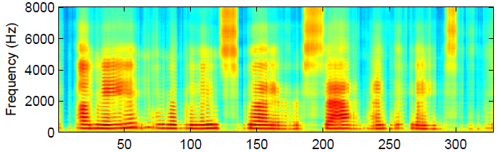
Dereverberation and denoising
Clean
Reverberant + factory
noise (T₆₀ = 0.6 s,
SNR = 0 dB)
Dereverberated
and denoised

Slide 81
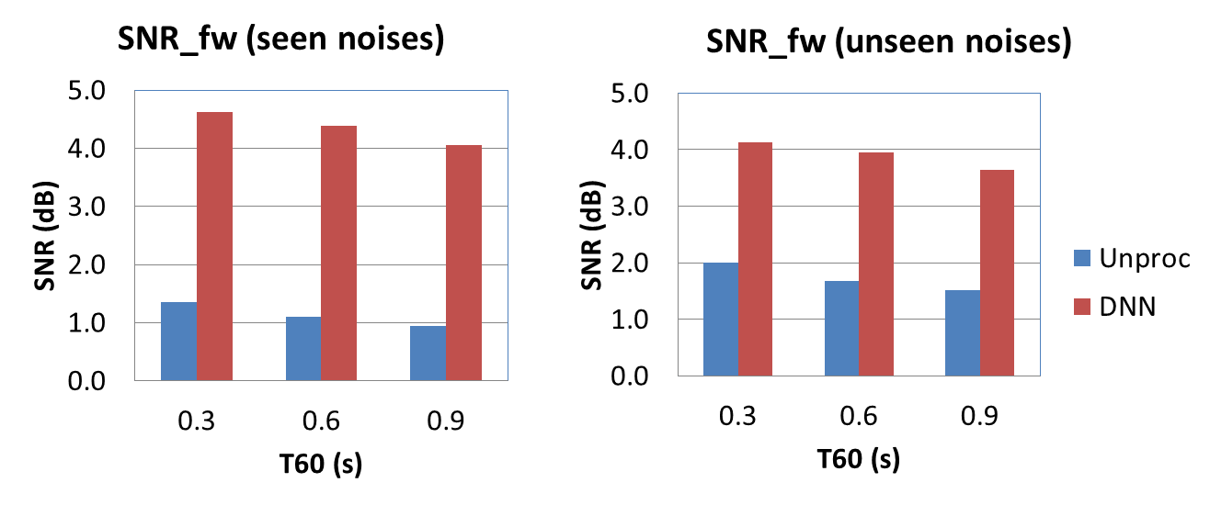
Results
Evaluation results on dereverberation and denoising (Han et al.’15)
Training: Multiple T₆₀’s (0.3, 0.6, 0.9 s) and noises (babble, factory, SSN at 0 dB)
Test: babble, factory, SSN and white, cocktail party, playground

Slide 82
Part V. Separation algorithms
Monaural separation
Speech-nonspeech separation
Complex-domain separation
Two-talker separation
Separation of reverberant speech
Binaural separation
Notes:
82

Slide 83
Binaural separation of reverberant speech
Speech separation has extensively used binaural cues
Localization, and then location-based separation
Beamforming (both fixed and adaptive) is the dominant approach
T-F masking for separation
Roman et al. (2003) proposed the first supervised method for binaural separation
DUET (Yilmaz & Richard’04) is the first unsupervised method

Slide 84
DNN based approach
Jiang et al. (2014) proposed DNN classification based on binaural features for reverberant speech separation
Interaural time difference (ITD) and interaural level difference (ILD)
Using binaural features to train a DNN classifier to estimate the IBM
Monaural GFCC features are also used
Systematic examination of generalization to different configurations and reverberation conditions

Slide 85
Training and test corpus
ROOMSIM is used with KEMAR dummy head
A library of binaural impulse responses (BIRs) is created with a room configuration: 6m×4m×3m
Three reverberant conditions with T₆₀: 0s, 0.3s and 0.7s
Seventy-two source azimuths
Azimuth angles from 0º to 355º, uniformly sampled at 5º, with distance fixed at 1.5m and elevation at zero degree
Target fixed at 0º
Number of sources: 2, 3 and 5
Target signals: TIMIT utterances
Interference: Babble
Training SNR is 0 dB (with reverberant target as signal)
Default test SNR is -5 dB

Slide 86
Evaluation at different input SNRs
Two sources with no reverberation and interference at an untrained angle
Input SNR (dB) | HIT (%) | FA (%) | HIT-FA (%) | Accuracy (%) | Output SNR (dB)
-15 | 72.26 | 0.31 | 76.95 | 99.26 | 2.94
-10 | 84.11 | 0.88 | 83.22 | 98.39 | 7.50
-5 | 86.65 | 1.83 | 84.82 | 96.99 | 11.86
0 | 89.63 | 3.09 | 86.54 | 95.52 | 15.08
5 | 90.92 | 4.65 | 86.27 | 94.01 | 16.68
10 | 91.27 | 6.88 | 84.39 | 92.33 | 16.25
Notes:
remain

Slide 87
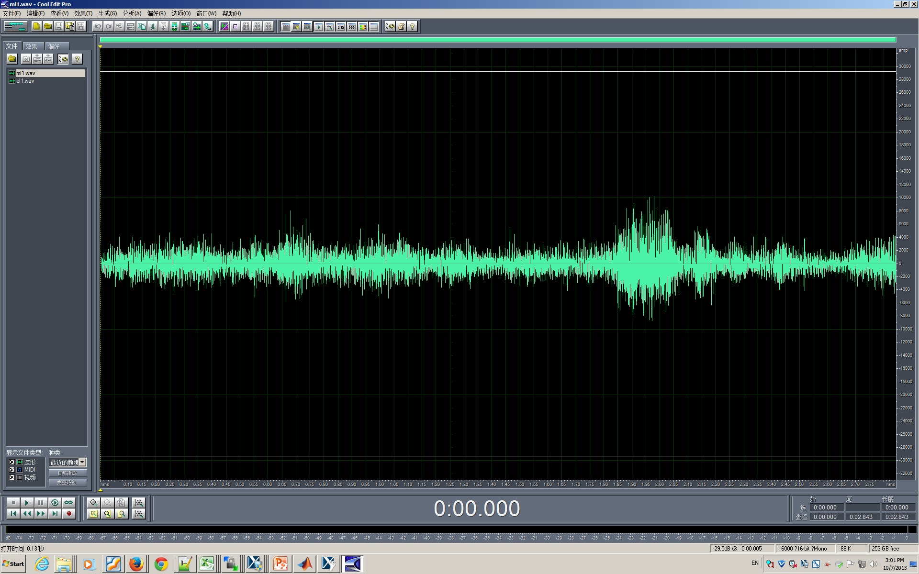
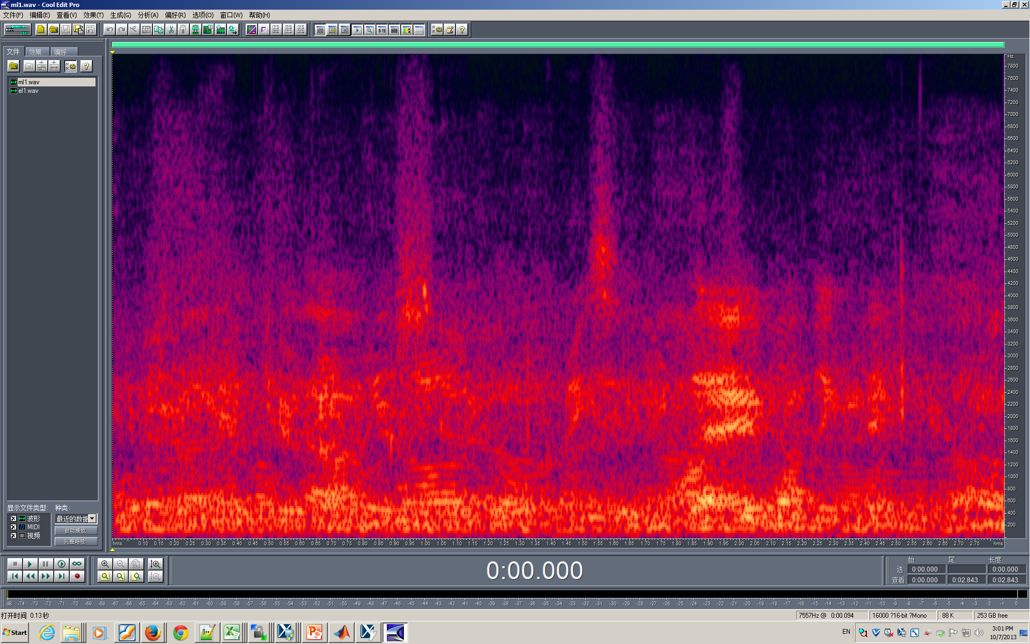
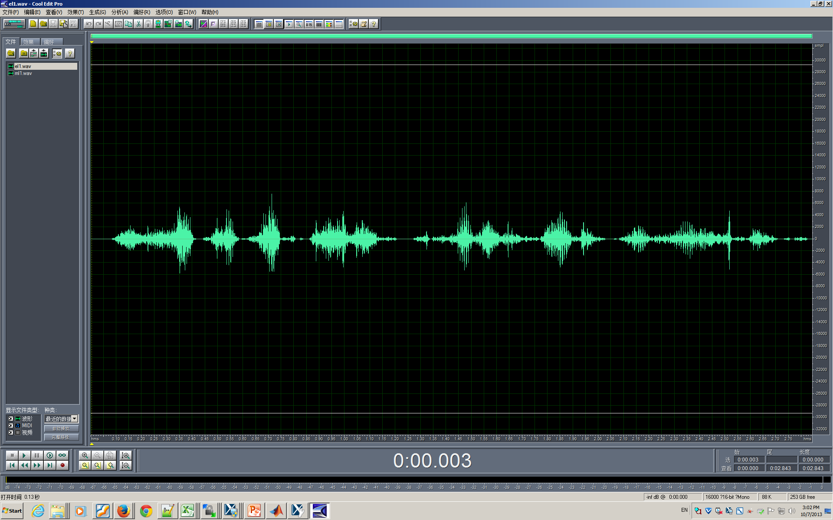

Sound demo
Two-source configuration at SNR = -10 dB
Mixture
Result

Slide 88
Generalization to untrained configurations
Two-source configuration with reverberation (0.3s T₆₀)
With reasonable sampling of spatial configurations, DNN classifiers generalize well

Slide 89
SNR comparisons
Five-source configuration
Input SNR: 0 dB
Comparisons with DUET, Roman et al. (2006), MESSL (Mandel et al.’10), and Woodruff & Wang (2013)
Results generalize to recorded BIRs

Slide 90
Part VI: Concluding remarks
Formulation of separation as classification or mask estimation enables the use of supervised learning
Advances in supervised speech separation in the last few years are impressive
Large improvements over unprocessed noisy speech and related approaches
This approach has yielded the first demonstrations of speech intelligibility improvement in noise
Very recent work incorporating phase leads to substantial quality improvement

Slide 91
Concluding remarks (cont.)
Supervised speech processing represents a major current trend
Signal processing provides an important domain for supervised learning, and it in turn benefits from rapid advances in machine learning
Use of supervised processing goes beyond speech separation and recognition
Multipitch tracking (Huang & Lee’13, Han & Wang’14)
Voice activity detection (Zhang et al.’13)
SNR estimation (Papadopoulos et al.’14)

Slide 92
Review of presentation
Introduction: Speech separation problem
Classifiers and learning machines
Training targets
Features
Separation algorithms
Monaural separation
Speech-nonspeech separation
Complex-domain separation
Two-talker separation
Separation of reverberant speech
Binaural separation
Concluding remarks

Slide 93
Resources and acknowledgments
DNN toolbox for speech separation
http://www.cse.ohio-state.edu/pnl/DNN_toolbox
Source programs for some algorithms discussed in this tutorial, e.g. MRCG derivation, are available at OSU Perception & Neurodynamics Lab’s website
http://www.cse.ohio-state.edu/pnl/software.html
Thanks to Jitong Chen and Donald Williamson for their assistance in the tutorial preparation

Slide 94
Cited literature and other readings
Ahmadi, Gross, & Sinex (2013) JASA 133: 1687-1692.
Anzalone et al. (2006) Ear & Hearing 27: 480-492.
Avendano & Hermansky (1996) ICSLP: 889-892.
Ayllon et al. (2013) EURASIP J. Adv. Sig. Proc.: 1-14.
Bronkhorst & Plomp (1992) JASA 92: 3132-3139.
Brungart et al. (2006) JASA 120: 4007-4018.
Cao et al. (2011) JASA 129: 2227-2236.
Chen et al. (2014). IEEE/ACM T-ASLP 22: 1993-2002.
Cherry (1957) On Human Communication. Wiley.
Dillon (2012) Hearing Aids (2nd Ed). Boomerang.
Erdogan et al. (2015) ICASSP: 708-712.
Gonzales & Brookes (2014) ICASSP: 7029-7033.
Han et al. (2014) ICASSP: 4628-4632.
Han & Wang (2014) IEEE/ACM T-ASLP 22: 2158-2168.
Han et al. (2015) IEEE/ACM T-ASLP 23: 982-992.
Hazrati et al. (2013) JASA 133: 1607-1614.
Healy et al. (2013) JASA 134: 3029-3038.
Helmholtz (1863) On the Sensation of Tone. Dover.
Hendriks et al. (2010) ICASSP: 4266-4269.
Hinton et al. (2016) Neural Comp. 18: 1527-1554.
Hu & Wang (2001) WASPPA: 79-82.
Hu & Wang (2004) IEEE T-NN 15: 1135-1150.
Huang & Lee (2013) IEEE T-ASLP 21: 99-109.
Huang et al. (2014) ICASSP: 1581-1585.
Huang et al. (2015) IEEE/ACM T-ASLP 23: 2136-2147.
Hummersone et al. (2014) In Blind Source Separation, Springer.
Ikbal et al. (2003) ICASSP: 133-136.
Jiang et al. (2014) IEEE/ACM T-ASLP 22: 2112-2121.
Jin & Wang (2009) IEEE T-ASLP 17: 625-638.
Kim & Stern (2010) Interspeech: 2058-2061.
Kim & Stern (2012) ICASSP: 4101-4104.
Kim et al. (1999) IEEE T-SAP 7: 55-69.
Kim et al. (2009) JASA 126: 1486-1494.
Kjems et al. (2009) JASA 126: 1415-1426.
Krawczyk & Gerkmann (2014) IEEE/ACM T-ASLP 22: 1931-1940.
Kumar et al. (2011) ICASSP: 4784-4787.
Li & Loizou (2008) JASA 123: 1673-1682.
Li & Wang (2009) Speech Comm. 51: 230-239.

Slide 95
Cited literature and other readings (cont.)
Loizou & Kim (2011) IEEE T-ASLP 19: 47-56.
Maganti & Matassoni (2010) Interspeech: 570-573.
Mandel et al. (2010) IEEE T-ASLP 18: 382-394.
May & Dau (2014) JASA 136: 3350-3359.
Narayanan & Wang (2013) ICASSP: 7092-7096.
Nie et al. (2014) ICASSP: 6717-6720.
Paliwal et al. (2010) Speech Comm. 53: 465-494.
Papadopoulos et al. (2014) ICASSP: 8287-8291.
Parry & Essa (2007) ICASSP: 661-664.
Roman & Woodruff (2013) JASA 133: 1707-1717.
Roman et al. (2003) JASA 114: 2236-2252.
Roman et al. (2006) JASA 120: 4040-4051.
Schadler et al. (2012) JASA 131: 4134-4151.
Shannon & Paliwal (2006) Speech Comm. 48: 1458-1485.
Srinivasan et al. (2006) Speech Comm. 48: 1486-1501.
Steeneken (1992) PhD: Univ. of Amsterdam.
Tu et al. (2014) ISCSLP: 250-254.
Virtanen et al. (2013) IEEE T-ASLP 21: 2277-2289.
Wang & Brown, Ed. (2006) Computational Auditory Scene Analysis. Wiley & IEEE Press.
Wang et al. (2008) JASA 124: 2303-2307.
Wang et al. (2009) JASA 125: 2336-2347.
WangY & Wang (2013) IEEE T-ASLP 21: 1381-1390.
WangY et al. (2013) IEEE T-ASLP 21: 270-279.
WangY et al. (2014) IEEE/ACM T-ASLP 22: 1849-1858.
Wenninger et al. (2014) GlobalSIP MLASP Symp.
Williamson et al. (2016) IEEE/ACM T-ASLP: in press.
Woodruff & Wang (2013) IEEE T-ASLP 21: 806-815.
Wu & Wang (2006) IEEE T-ASLP 14: 774-784.
Xu et al. (2014) IEEE Sig. Proc. Lett. 21: 65-68.
Yilmaz & Rickard (2004) IEEE T-SP 52: 1830-1847.
Yuo & Wang (1999) Speech Comm. 28: 13-24.
Zhang & Wu (2013) IEEE T-ASLP 21: 697-710.

